Slide 1
UNRAVELING PATTERNS IN US – ACCIDENTS
AGENDA
INTRODUCTION
GOALS
DATA
FINDINGS
CONCLUSIONS
COURSE NAME: MACHINE LEARNING
COURSE CODE: CSCI 5622
INSTRUCTOR: DR. AMI GATES
PRESENTER: TRINAY GANGISETTY

Slide 2



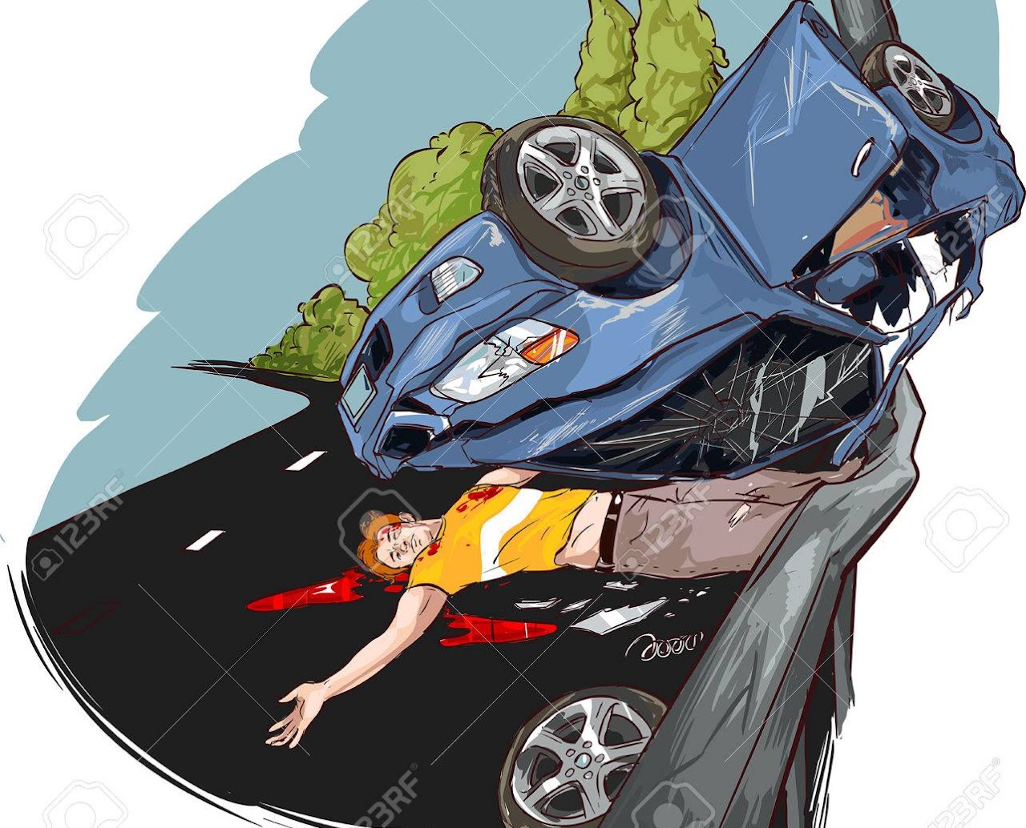





INTRODUCTION:
1. WHAT
2. WHY
3. WHICH
4. WHO

Slide 3
WHY ARE ACCIDENTS CAUSED ?
NEGLIGENCE
DISTRACTION
SPEEDING
WEATHER
FATIGUE
IMPAIREMENT
WHO IS RESPONSIBLE FOR THE ACCIDENTS?
YOU
ME
ANYONE
WHAT ARE TYPES OF ACCIDENTS?
COLLISIONS
SINGLE VEHICLE CRASHES
ROLLOVERS
SLIP AND FALLS
BICYCLE ACCIDENTS
WHICH ROAD CONDITIONS ARE RESPONSIBLE?
WET PAVEMENT
SNOWY ROADS
UNEVEN SURFACES
SHARP CURVES
BLIND SPOTS
ROAD DEBRIS
CONSTRUCTION ZONES

Slide 4
GOALS/ RESEARCH QUESTIONS:
TOPICS
GEOGRAPHICAL
TEMPORAL
ENVIRONMENTAL
INFRASTRUCTURAL
URBAN
RURAL

Slide 5
GEOGRAPHICAL
TEMPORAL
ENVIRONMENTAL
. How does accident severity vary across U.S. states?
. Which areas consistently have high accident severity?
. What geographical factors influence accident severity?
Are there weekly or monthly patterns in accident severity?
When during the day are accidents most severe?
Do specific times or astronomical phases affect accident severity?
How do weather conditions affect accident severity?
Is wind speed correlated with accident severity?
What impact do different road conditions have on severity?

Slide 6
INFRASTRUCTURAL
URBAN
RURAL
How do road features like roundabouts affect severity?
Does proximity to critical locations affect accident severity?
How does time of day interact with traffic signals to influence severity?
How severe are urban accidents compared to suburban and rural?
What causes accidents in crowded urban areas?
Do specific urban road features affect accident severity?
Are rural accidents more severe than urban ones?
What challenges affect road safety in rural areas?
How do rural conditions impact accident severity?

Slide 7


RAW DATA
80 LAKH ROWS
46 COLUMNS
2 LAKH MISSING VALUES
2016-2023

Slide 8
CLEANED DATA:
SAMPLED 15000 ROWS FROM EACH YEAR TO ENSURE THERE IS NO BIAS
SPENT MORE THAN 24 HOURS CLEANING THE DATA

Slide 9
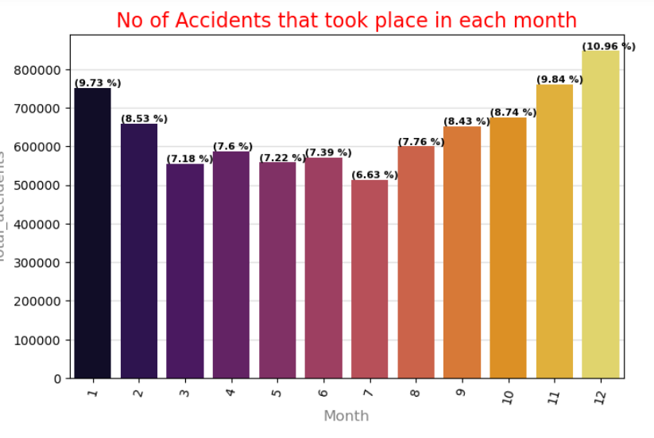
FINDINGS:

Slide 10
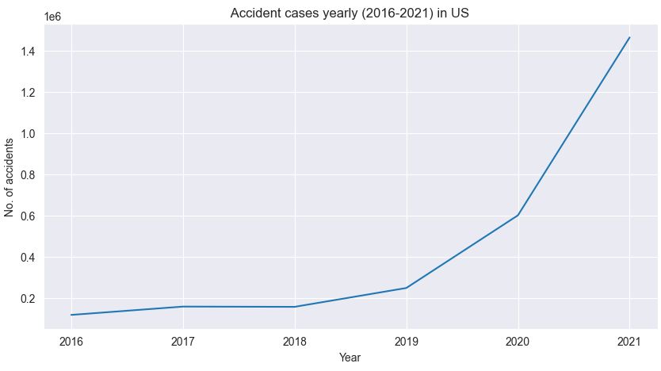
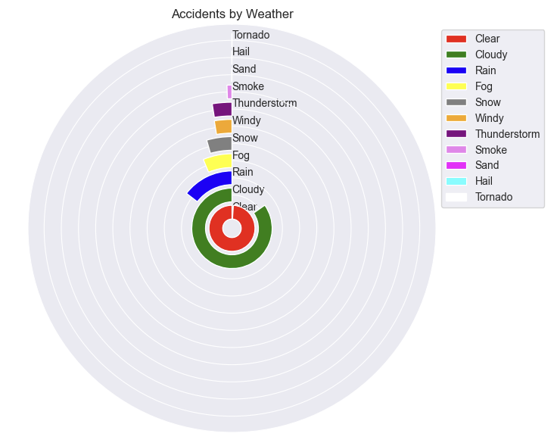
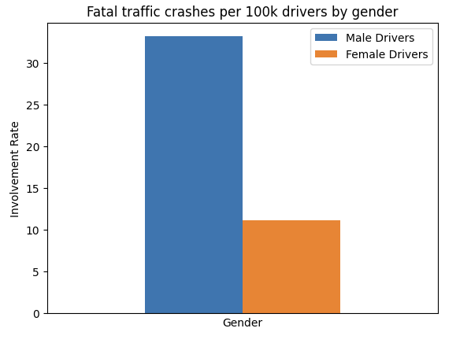
FINDINGS:

Slide 11
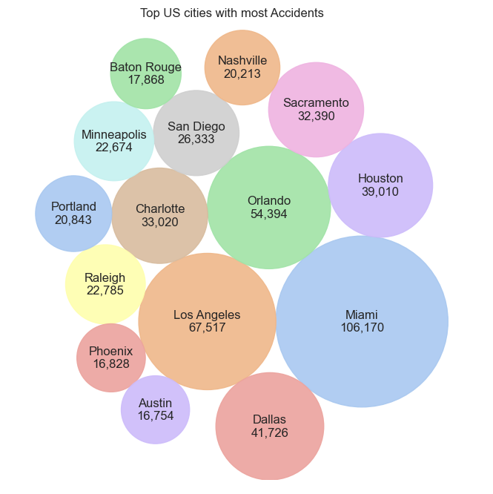
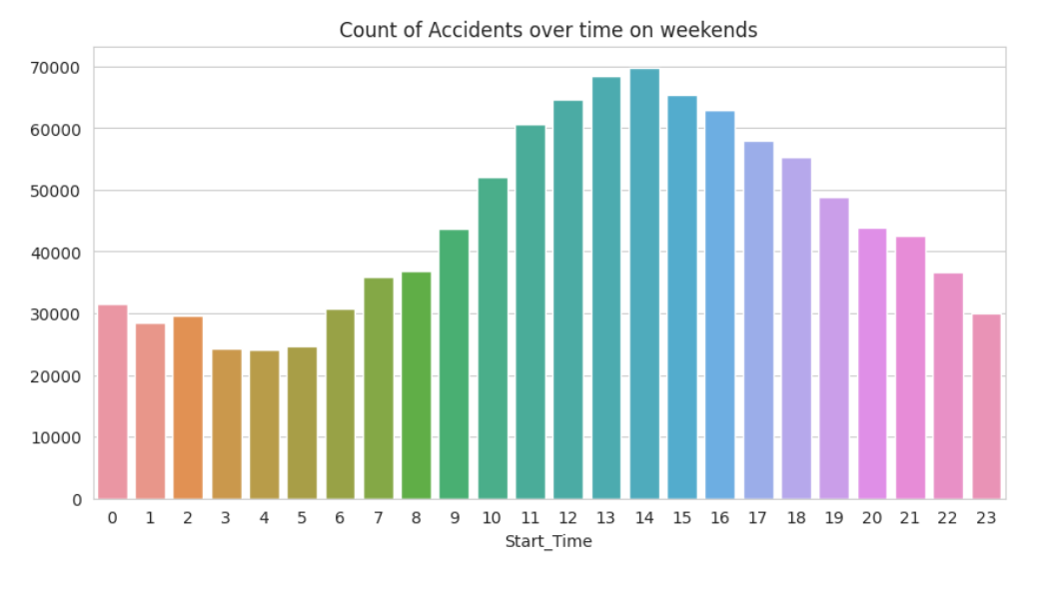
FINDINGS:

Slide 12
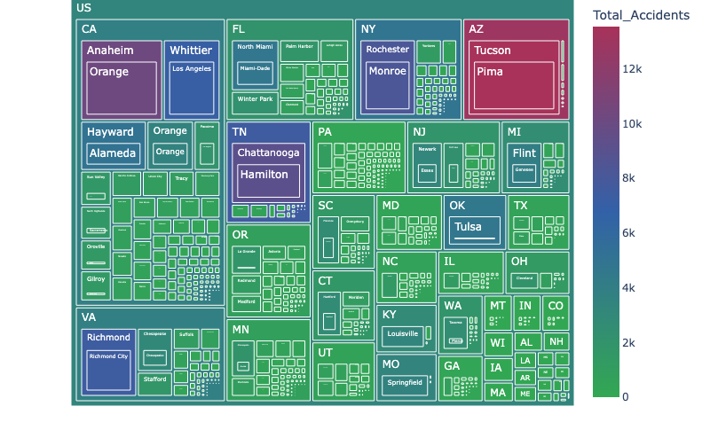

Slide 13
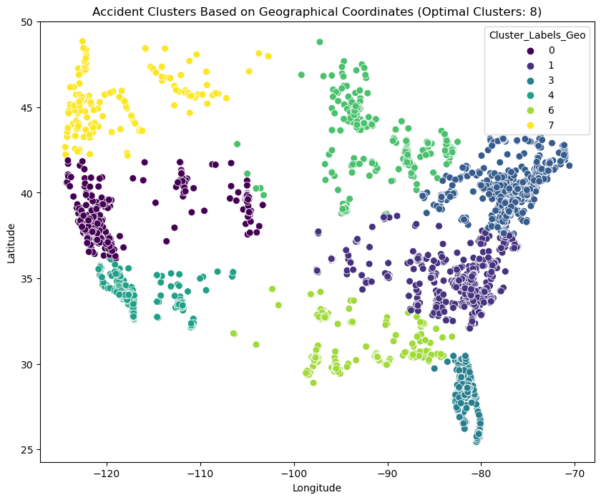
FINDINGS:
Geographical coordinates.
Distinct spatial patterns: High density.
Clusters align: Urban areas, roadways.
Visualization: Map shows patterns.
Insight into accident distribution.

Slide 14
CONCLUSION:
Road safety is critical in today's world.
Educational Campaigns
Technological Innovations
Connected Infrastructure
Collaborative efforts are key.
Understanding factors like driver behavior and infrastructure is crucial.
Despite efforts, US faces rising accidents.
Machine learning aids in predicting and preventing accidents.
Data-driven strategies are vital for safer roads.

